Slide 1
Resume Builder Pro
Create Professional Resumes Effortlessly

Slide 2
Agenda
Introduction
Key Features
Technology Stack
User Authentication
Resume Sections
Future Roadmap

Slide 3
Introduction
Resume Builder Pro revolutionizes resume creation by combining smart technology with beautiful design. Our platform eliminates the frustration of formatting while helping you showcase your professional journey effectively.
Key Value Propositions:
For Job Seekers: "Spend time perfecting your content, not fighting with margins - we handle the formatting magic."
For Career Changers: "Adapt your experience seamlessly for new industries with our flexible templates."
For Students: "Transform limited experience into a professional presentation that stands out

Slide 4
Key Features
*3+ Professional Templates *Custom Color Schemes *Real-Time Preview *PDF & JSON Export * Auto-Save Functionality

Slide 5
Technology Stack
Frontend:
React.js (Interactive UI)
Tailwind CSS (Styling) Libraries:
html2pdf.js (PDF generation)
Font Awesome (Icons) Storage:
Browser localStorage

Slide 6
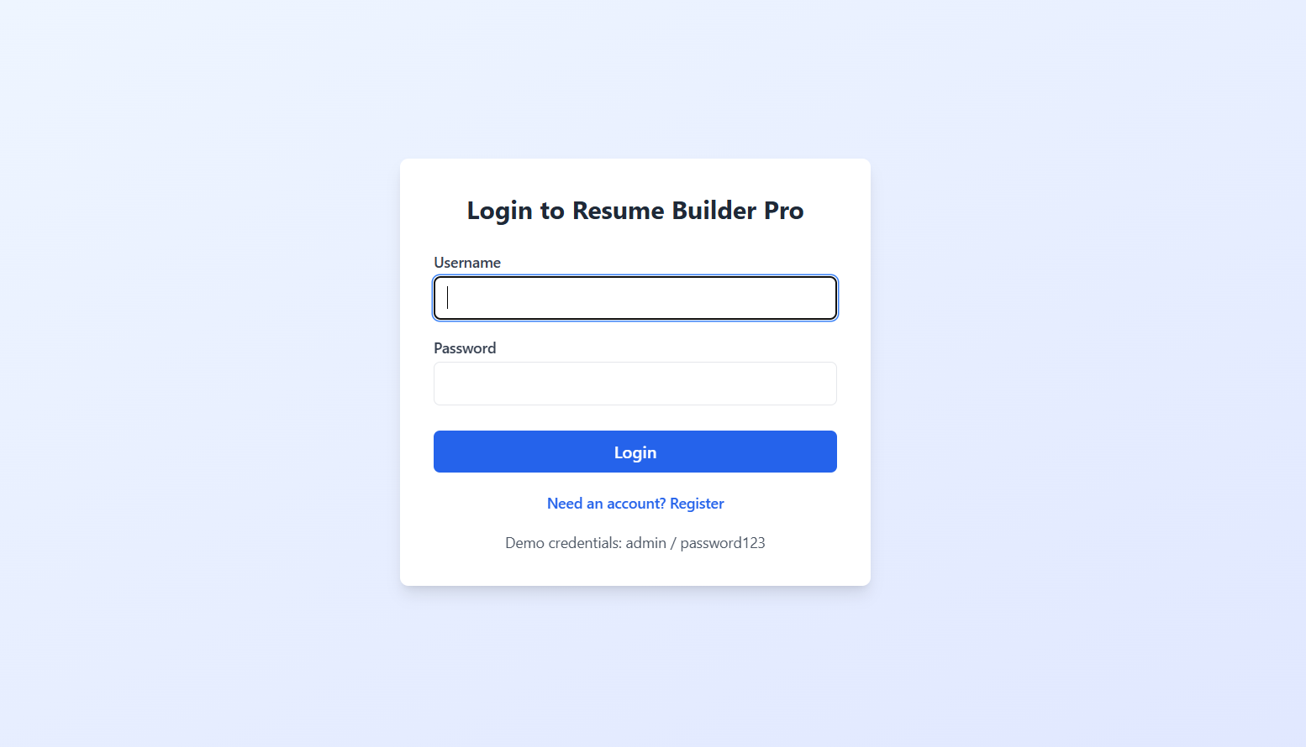
User Authentication
Login/Register system

Slide 7
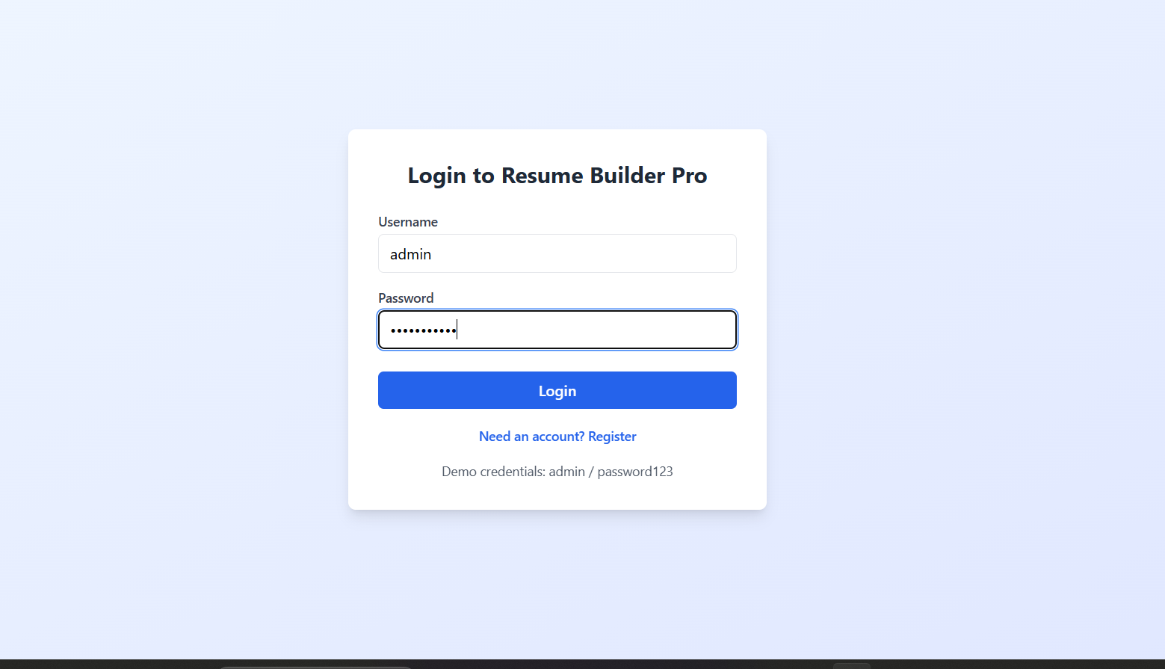
Demo mode (admin/password123):

Slide 8
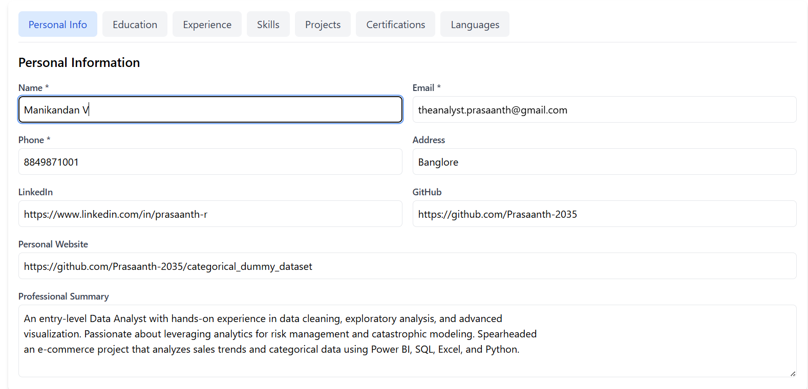
Resume Sections:
Personal Info

Slide 9
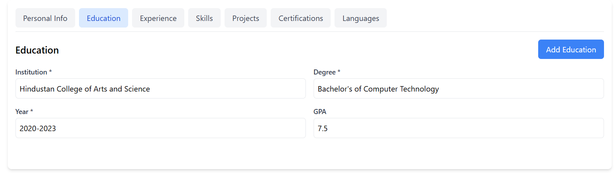
Education:

Slide 10
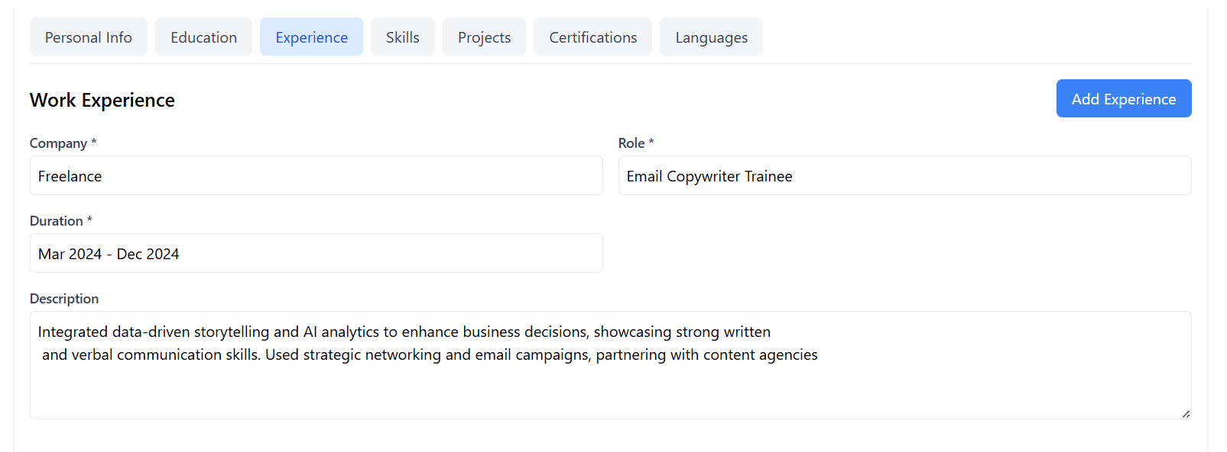
Work Experience:

Slide 11
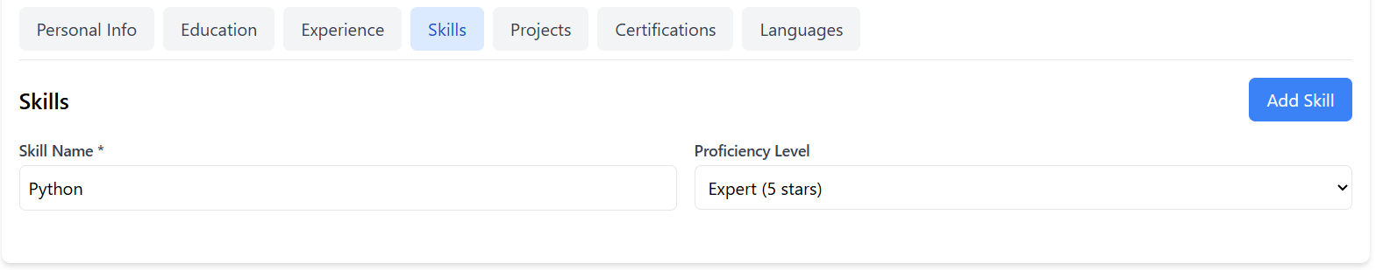
Skills:
Skills

Slide 12
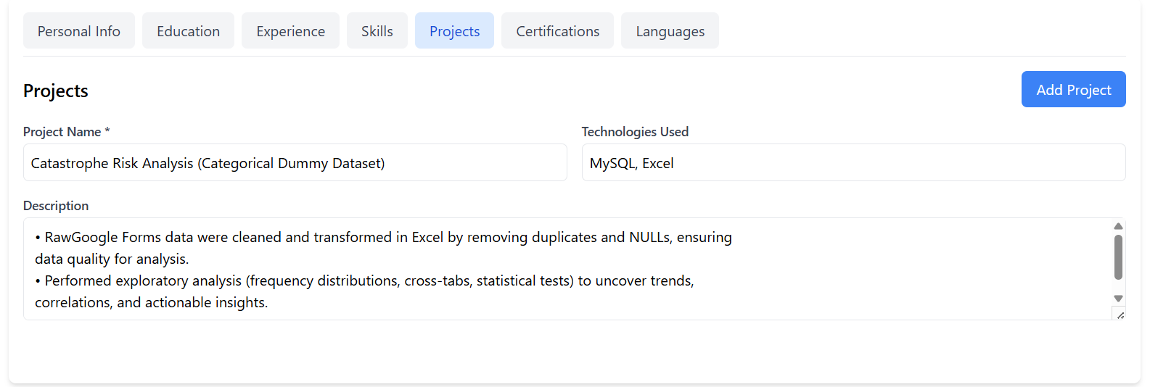
Projects:

Slide 13
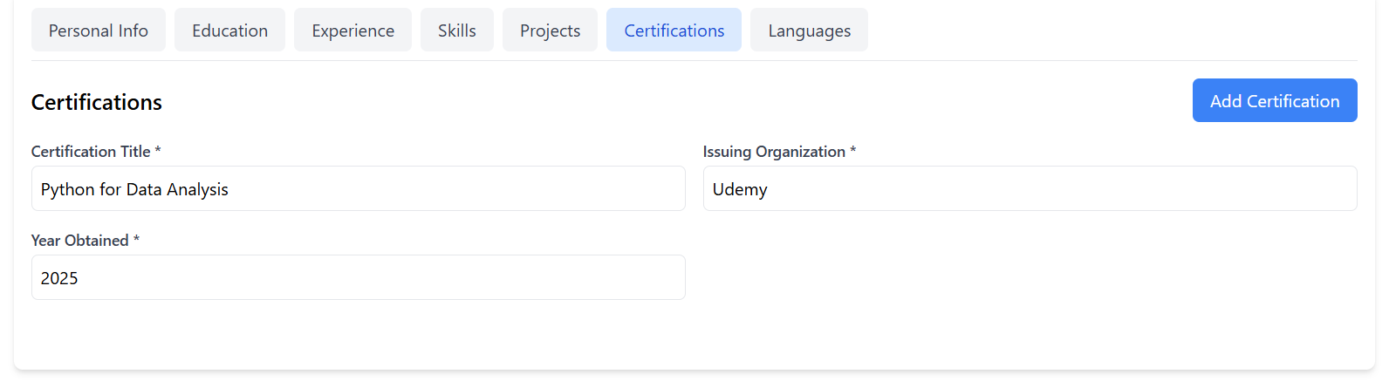
Certifications:

Slide 14
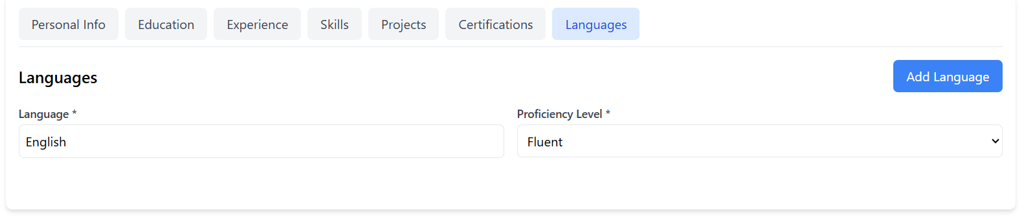
Languages:

Slide 15
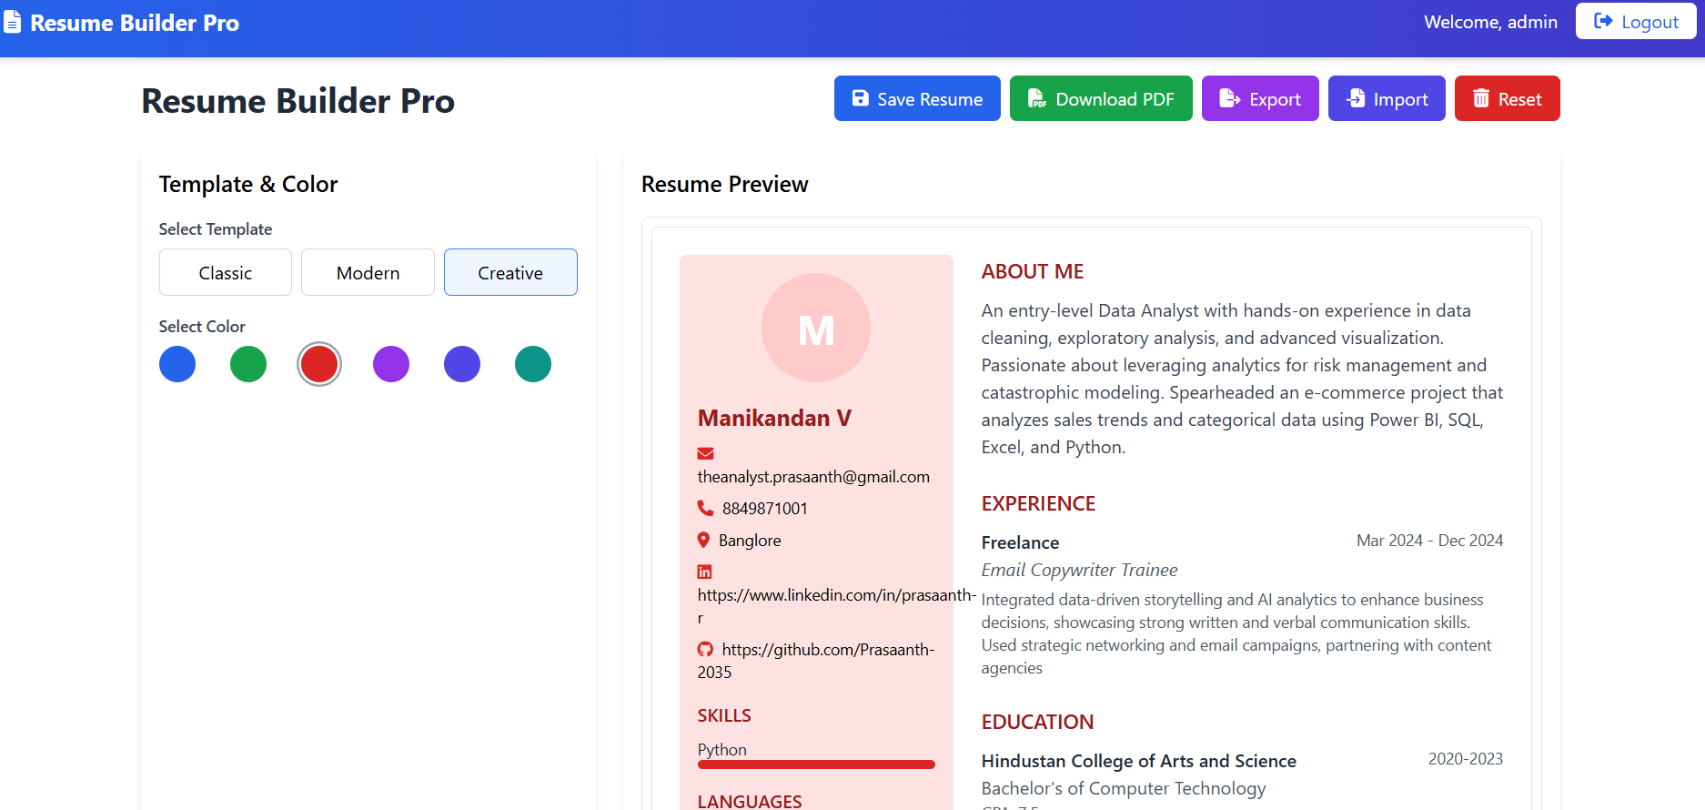
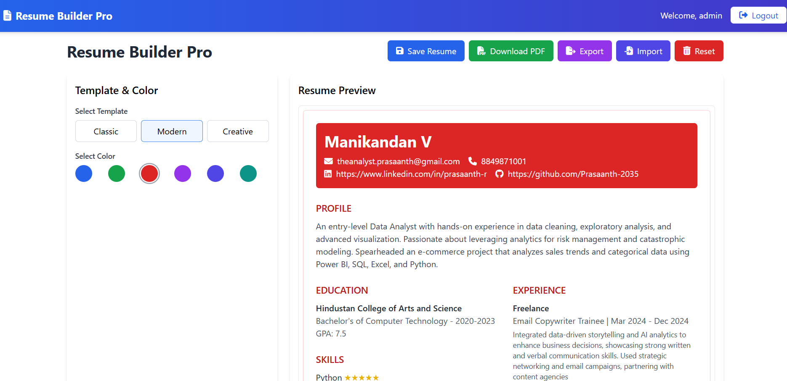
Template designs:

Slide 16
Future Roadmap:
AI-powered content suggestions
Cloud sync (Firebase integration)
Cover letter builder
Multi-language support

Slide 17
Thank you.

